Slide 1
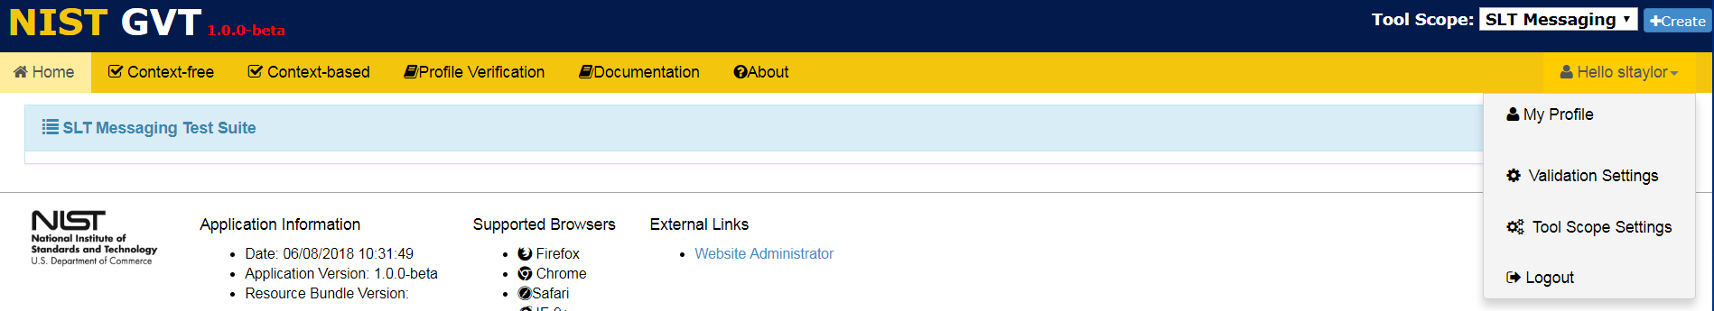
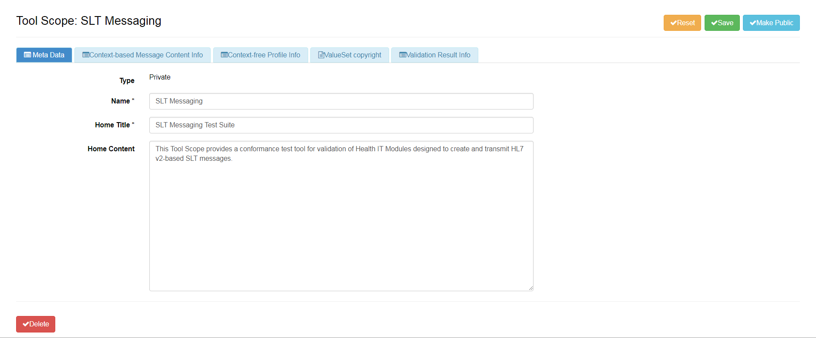
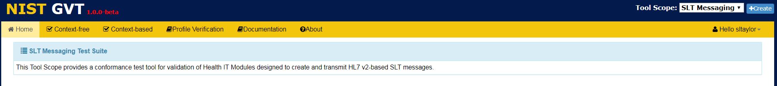
Accessing and Updating Tool Scope Settings (1)
From the dropdown menu, select Tool Scope Settings to add or edit Settings information for the Scope displayed in the Tool Scope field.
shows where this info is used
1
2
Add or edit Tool Scope Setting Meta Data in the edit window.
Optional: Click on √Make Public to make this Tool Scope available to all GVT users.
Save Meta Data Tool Scope Settings or select another tab on this window to add or edit data.
3
info
“Private” is default setting
4
Click on √Delete to delete this entire Tool Scope.

Slide 2
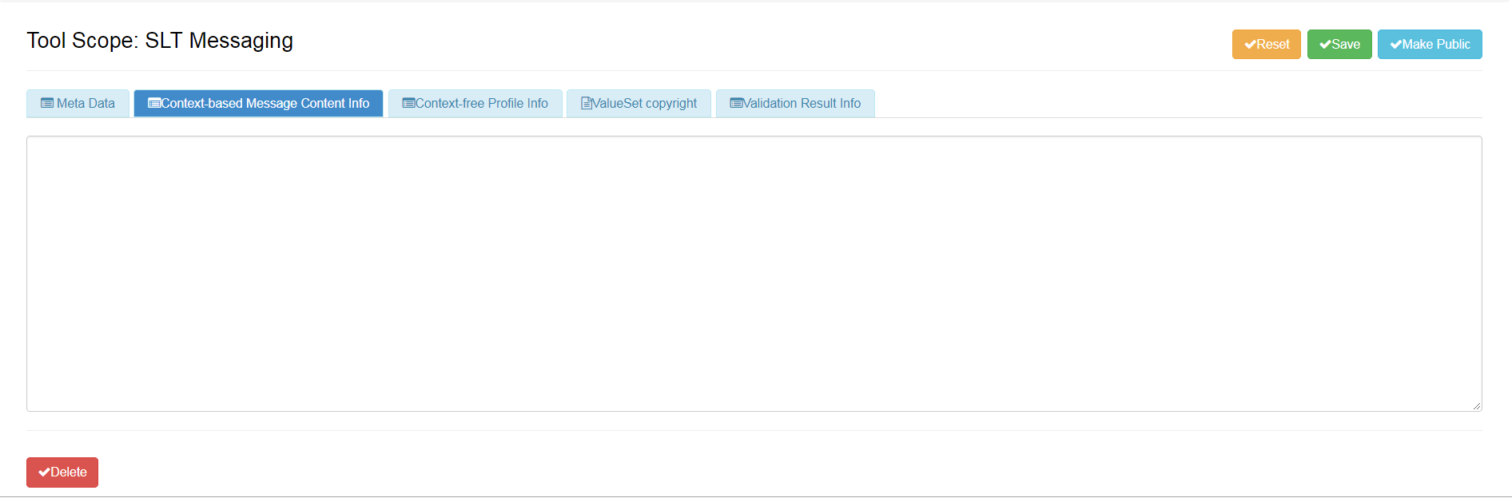
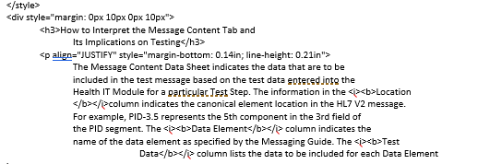
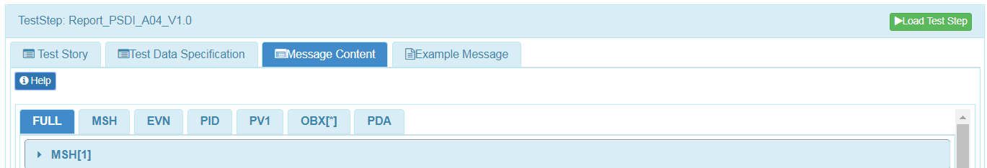
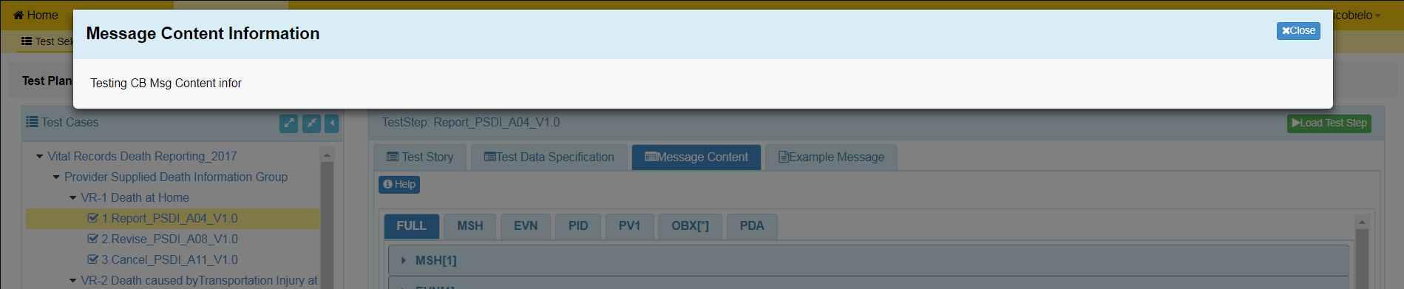
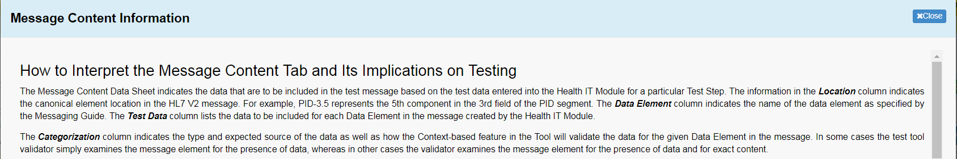
Accessing and Updating Tool Scope Settings (2)
From the dropdown menu, select Tool Scope Settings to add or edit Settings information for the Scope displayed in the Tool Scope field.
shows where this info is used
5
6
Select the Context-based Message Content Info tab in the Tool Scope Setting edit window and add or edit this information.
Save Context-based Message Content Info or select another tab on this window to add or edit data.
7

Slide 3
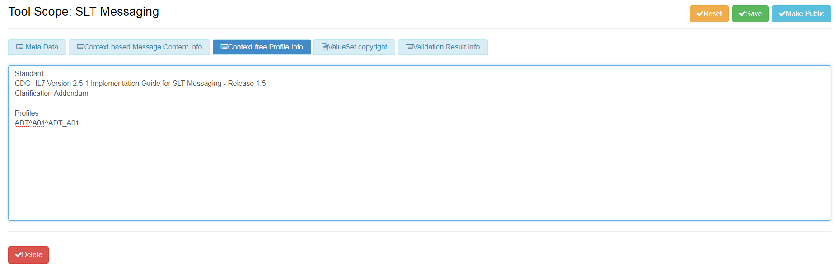
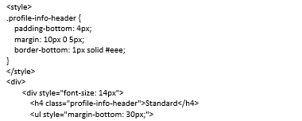
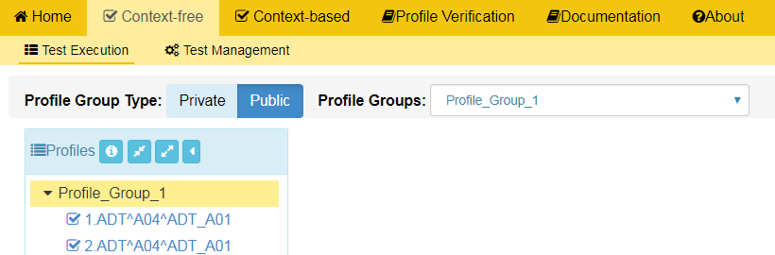
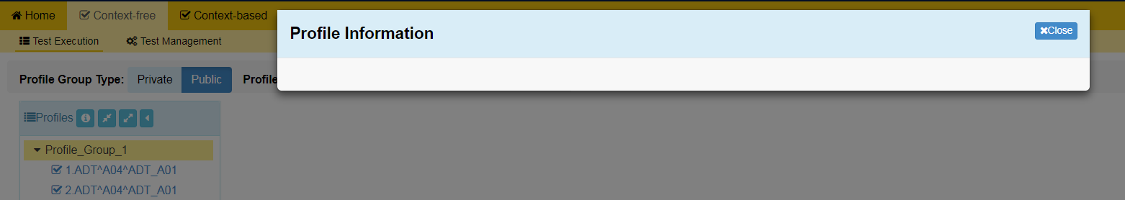
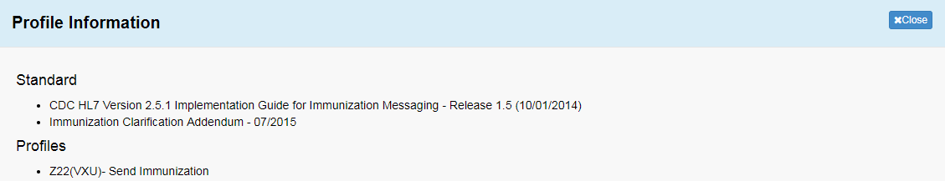
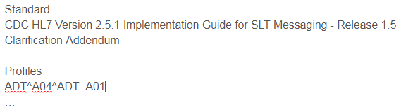
Accessing and Updating Tool Scope Settings (3)
From the dropdown menu, select Tool Scope Settings to add or edit Settings information for the Scope displayed in the Tool Scope field.
shows where this info is used
8
9
Select the Context-free Profile Info tab in the Tool Scope Setting edit window and add or edit this information.
Save Context-free Profile Info or select another tab on this window to add or edit data.
10

Slide 4
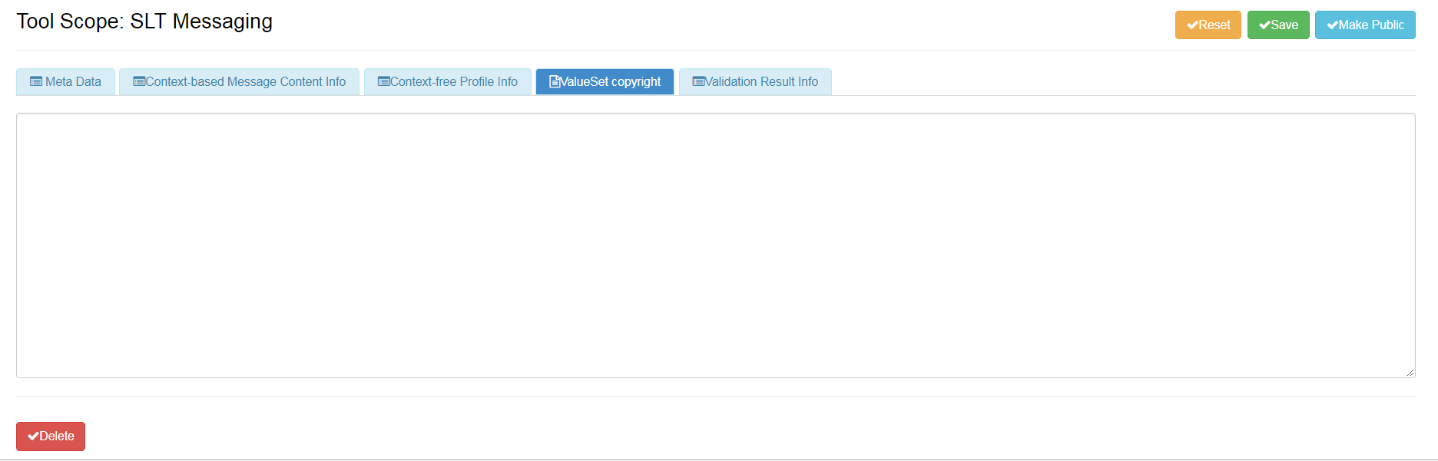
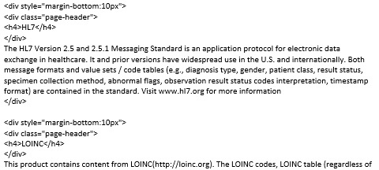
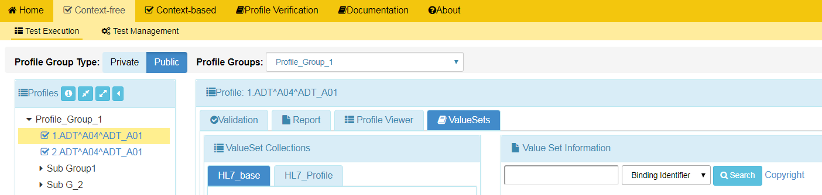
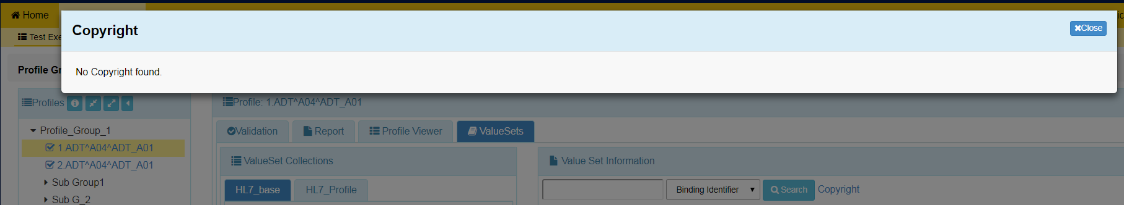
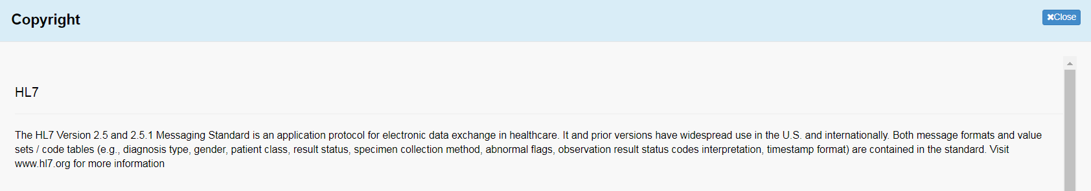
Accessing and Updating Tool Scope Settings (4)
From the dropdown menu, select Tool Scope Settings to add or edit Settings information for the Scope displayed in the Tool Scope field.
shows where this info is used
11
12
Select the ValueSet Copyright tab in the Tool Scope Setting edit window and add or edit this information.
Save ValueSet Copyright or select another tab on this window to add or edit data.
13

Slide 5
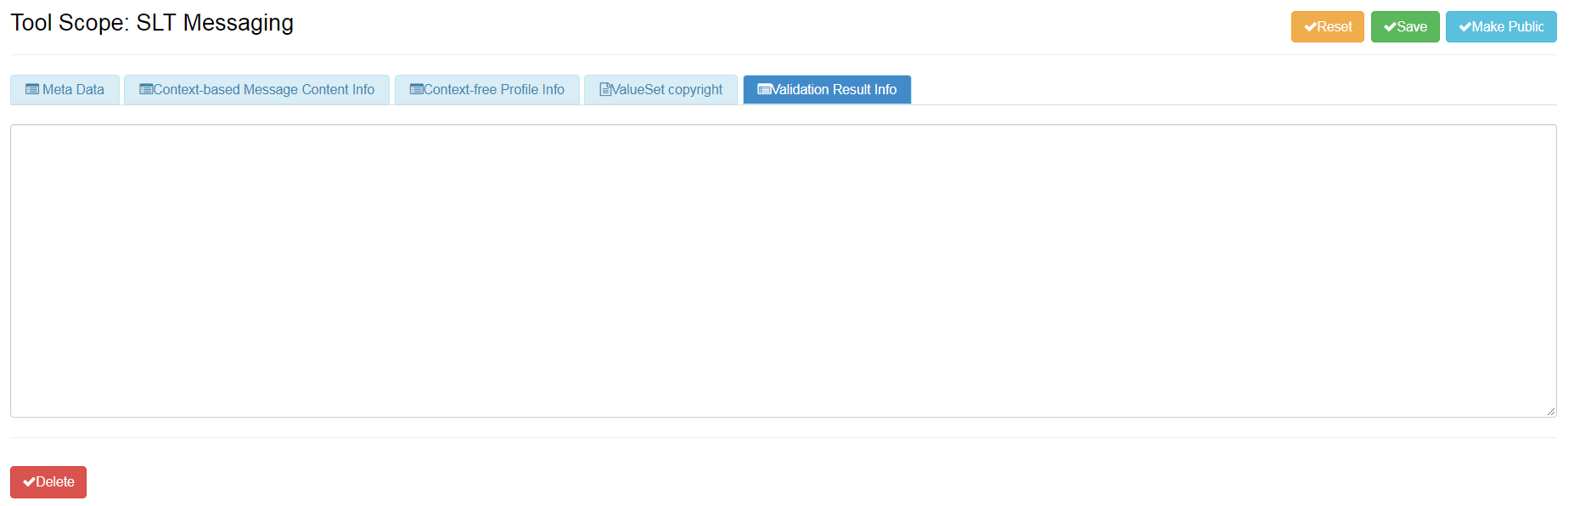
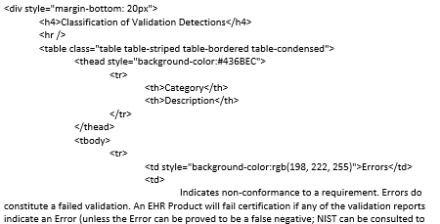
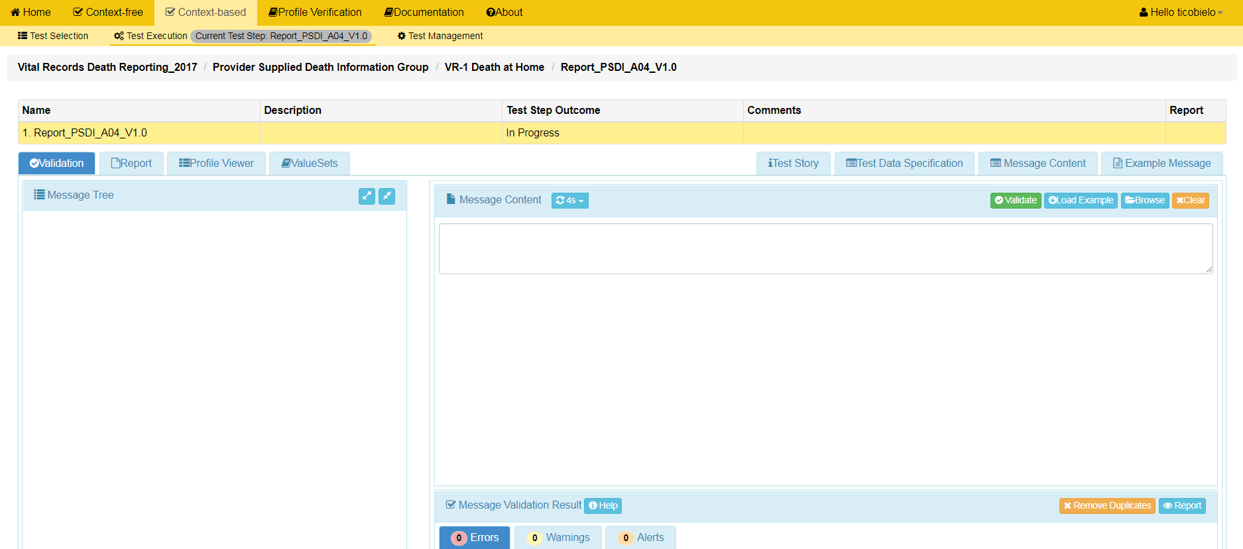
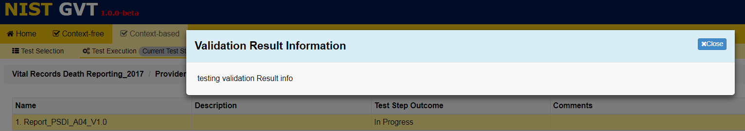
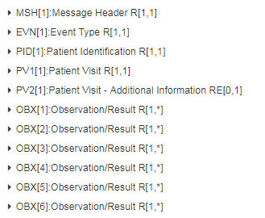
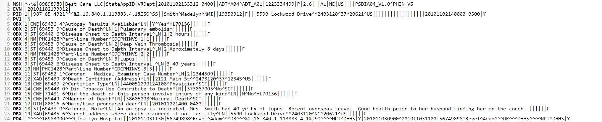
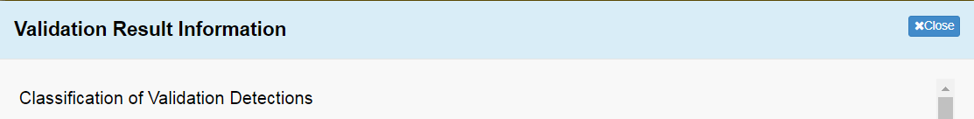
Accessing and Updating Tool Scope Settings (5)
From the dropdown menu, select Tool Scope Settings to add or edit Settings information for the Scope displayed in the Tool Scope field.
shows where this info is used
14
15
Select the Validation Result Info tab in the Tool Scope Setting edit window and add or edit this information.
Save Validation Result Info or select another tab on this window to add or edit data.
16

